Slide 1


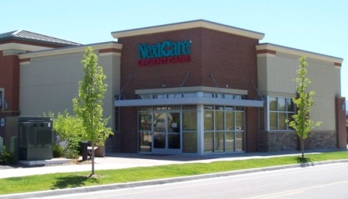


NextGen Client Innovation Contest
2017 – 10 – 08
Kevin Foster

Slide 2
WHO WE ARE
Urgent Care Specialty
140 Clinics across 14 Practices
Operate in 10 States
4 Separate Time Zones (AZ, MST, CST, EST)
Provider Count = 550+ Full/Part Time

Slide 3

OUR PROBLEM
Providers may work at different locations each day
Providers may only work once or twice a week
So, how can we provide effective patient follow-up care?

Slide 4

OUR PROBLEM (CONT.)
The PAQ is not an option!
Patient follow-up is the clinics’ responsibility
Labs
Referrals
Diagnostic Studies
Follow-up / Worker’s Comp Visits

Slide 5
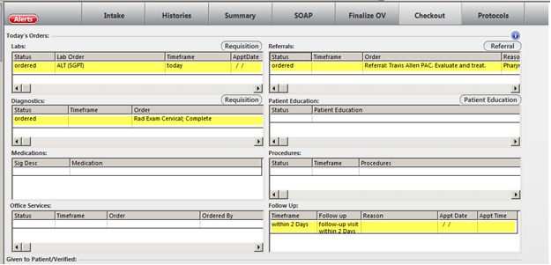
THE GOOD
All Orders are Stored in the Same Place!
KBM Orders Include a Provider and a Location

Slide 6
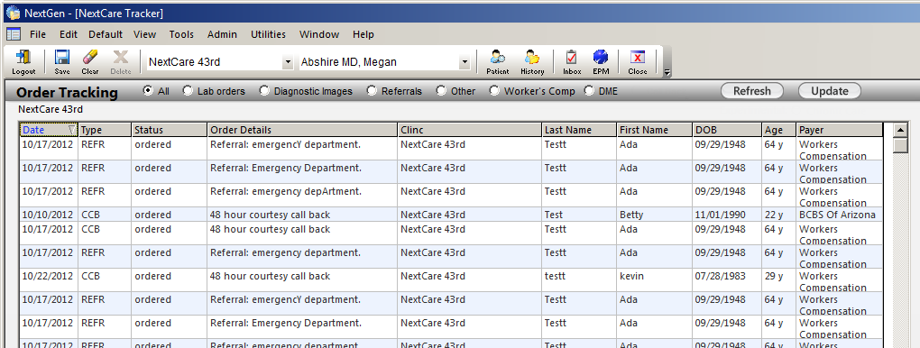
OUR SOLUTION
A Practice Template dubbed...
“The Tracker”

Slide 7
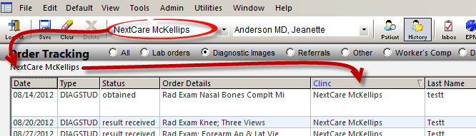
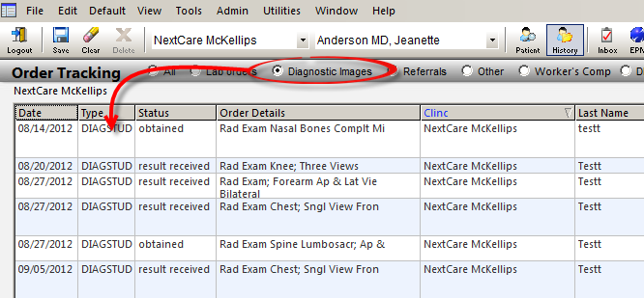
USER INTERFACE
Clinic Filter
Order Type Filter:
Displays if Status is NOT: Completed, Canceled, or Deleted

Slide 8
USER INTERFACE
Order Type Filter:
* Denotes a custom order type
Order Type | actClass
All | Any listed below
Lab orders | Lab, Lab Office
Diagnostic Images | PUL,DIAGSTUDY,DIAGIMG,XRAY,CARD,EKG,…
Referrals | REFR,PT
Other | OTHER,OB,GYN,OV,PHYS,PT,TRANSPORT
Worker’s Comp | REFR,PT
DME | DME,MEDSUPPLY
Call Back* | CCB
DOT Action* | DOT
Billing Action* | CBO

Slide 9
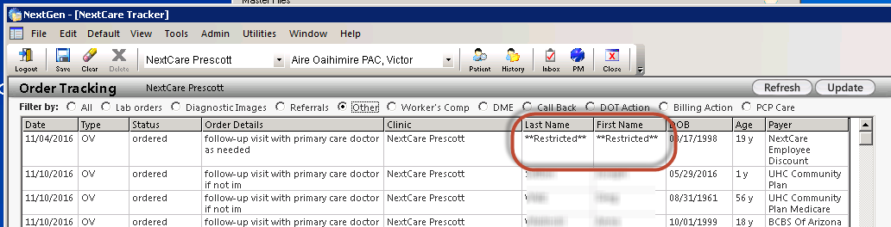
USER INTERFACE
Privacy Mask:
Action Buttons:

Slide 10
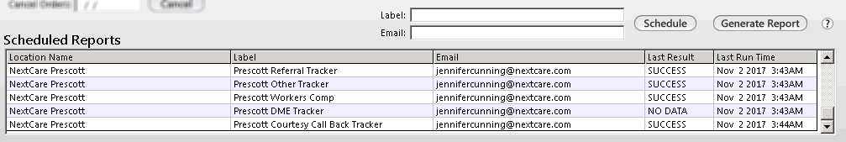
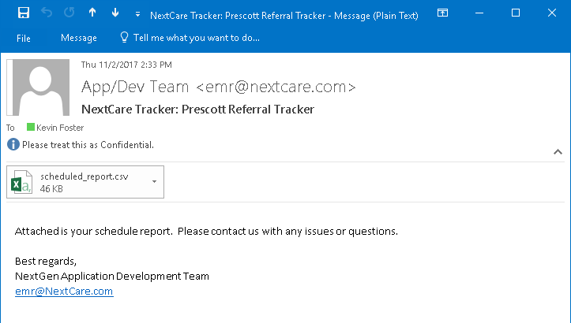
USER INTERFACE
Scheduled Reports:

Slide 11
BEHIND THE SCENES
A single stored procedure drives the data grid
EXEC appdev_order_mgmt
@design --used to make the data grid work
@pi_practice_id --the current practice_id
@pi_location_name --the current location name
@pi_actClass --the radio button selected
@pi_user_id --the current user
EXEC appdev_order_mgmt 1, ’0001’, ’NextCare 59th’, ‘L’, ‘2600’

Slide 12
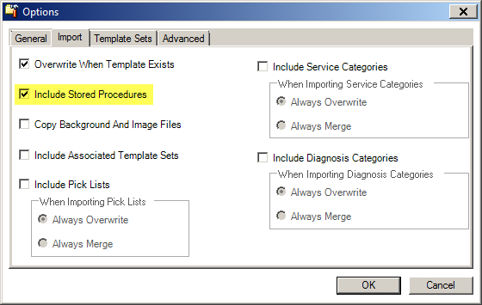
GETTING STARTED
No Configuration Required
Import the template with the “Include Stored Procedures” option enabled.

Slide 13

DEMO

Slide 14
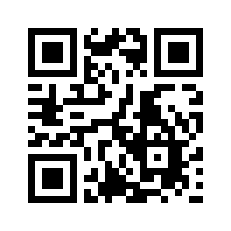
QUESTIONS?
Kevin Foster kevinfoster@nextcare.com
Download the files here:
https://goo.gl/vpbNYf
Thank You!

